Slide 1
DEPARTMENT OF PHYSICS GOVT. E.V.P.G. COLLEGE KORBA DEPARTMENTAL REPORT 2019-20

Slide 2
About the Department
Department of Physics was established in the year 1981. The Department
Currently offers physics as a subject in B.Sc. And master of Science in Physics(M.Sc. Physics).Department is Well Established within the college Campus. Presently there are two classrooms and two Laboratories available.
All the classrooms and laboratories are well equipped with necessary furnitures to carry out
regular teaching and practical activities . Classroom and student laboratories are provided
with Black boards and oerhead Projectors to enable ICT Method of teaching with Wi-fi.
Qualified and dedicated faculty of the department are always ready to assist the student.
Programme Offered: B.sc (Physics as a subject), M.Sc. Physics .
Eligibility for Admission
Candidates with Bachlors degree in science with Physics as a Major/Optional subject.
Admission is Done on the merit basis and as per the state govt. Guidelines.

Slide 3
Programme Objectives
To ensure that student can achieve an up-to-date level of understanding of Physics .
To Increase the awareness on identification of insruments used in Physics Practical.
Capacity to think critically, ability to design and execute an experiment; confidence in
communicating ideas.
Programme Outcome
At the completion of M.sc. in Physics the students are able to
Knowledge and understanding of range of Physics Equipments.
Think logically and organise task into a structured from an assimilate knowledge and ideas
Based on wide reading of text books and through the internet.
Transfer of knowledge and method from one topic to another within the subject.
Carry out practical work in the field and in the laboratory with minimal risk.
Apply the scientific knowledge of basic physics and life science.
Conduct investigations of complex problems by the use research based knowledge on an
independent term project.

Slide 4
Alumini Record
S.no. | Session | Name | Designation | Place
1. | 2011-12 | Dolly Agrawal | Assistant Professor | Govt. E.V.P.G. College Korba
 |  | Priyanka Vishwakrma | Teacher | Kendriya vidyalaya Balco
 |  | Supriya Dhoke | Shikshakarmi Varg-I | Jashpur
2. | 2012-13 | Sonu Verma | Lecturer | Polytechnic College Korba
 |  | Rishi Rathore | PGT(Teacher) | St. Vicent Polity School Korba
 |  | Mahesh Pandey | Teacher | Nirmala english Medium School
3. | 2013-14 | Parvati Kanwar | Superintendent of hostal | Urga (Korba)
 |  | Swarnlata Sahu | Assistant Professor | Govt. E.V.P.G. College Korba
4. | 2014-15 | Dyeshwari Sahu | Assistant Professor | Govt. E.V.P.G. College Korba
 |  | Rohini Rao | Assistant Professor | Shri Agrasen College Korba
5. | 2015-16 | Mugdha Patkar | Assistant Professor | K.N. College Korba

Slide 5
Students Achievements:
S.no. | Name of Students | Achivements
1. | Shyam Sundar Tiwari | NET Qualified
2. | Anil Kumar Kaiwat | NET Qualified
3. | Seema Singh Shatriya | Gold Medalist
4. | Dolly Agrawal | 3rd rank in Merit list

Slide 6
Research oriented activities
Lectures | NIL
Expert Lectures | 01.By Dr. R.S kher 02.By Shri Pradeep Khetrapal
Project work | Project works submitted by M.Sc. Final Students.

Slide 7
Laboratory facilities
The Physics laboratories are specialized equipped to conduct advaced practicals and research
Work. The laboratories are equipped with equipments like Microscope ,Ammeter,Calorimeter,
Electrometer, thermometer , calipers.
Other facilities
PG library of the department contains 734 books.
Notes on various topics are available in the departmentental library.
Books related to competitive exams are also available.
Smart room available for seminar on differerent topics (for PG students).
Online Content available through various MHRD schemes.
Teaching and learning through smart class
Students participation in NCC/NSS/Sports.

Slide 8
Achievements of the Department
Students of M.sc. Physics IV Semester received Second prize for the best Paper presentation In district level research seminar(2018).
Students of M.sc. Physics IV semester received second prize for the best paper presentation in district level research seminar (2019).
Details of faculty members with qualification
S.NO | NAME | QUALIFICATION | DESIGNATION | EXPERIENCE
01 | Mr. SHYAM SUNDAR TIWARI(till dec. 2020) | M.Sc. , NET | Asst. Professor | 2years 10months
02 | ANIL CHAKRADHARI | M.sc. ,SET | Guest Lecturer | 1 YEAR
03 | Mr. LOKENDRA DANSENA | M.Sc. | Guest Lecturer | 1 YEAR
04 | Mr. SHUBHAM SHARMA | M.Sc. | Guest Lecturer | 1 YEAR

Slide 9
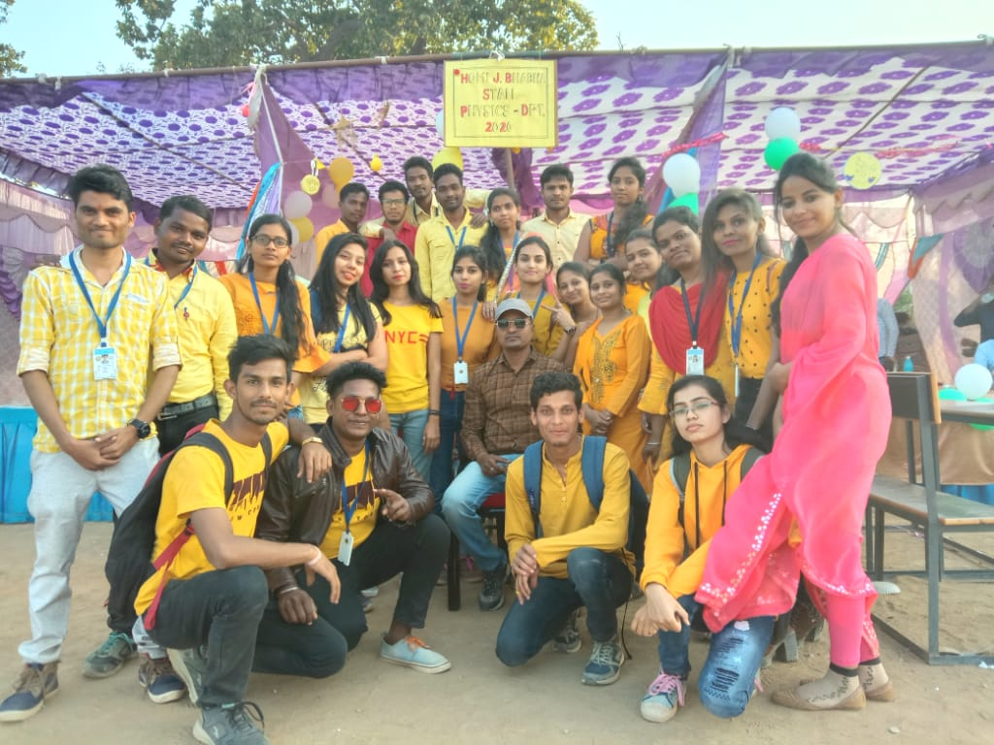
PHOTO GALLERY
All Students and Teachers of the Department

Slide 10
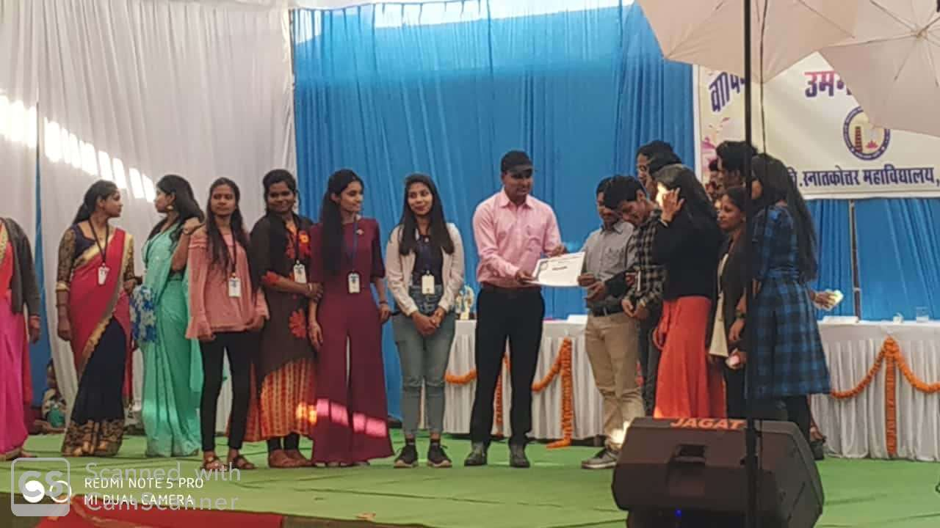
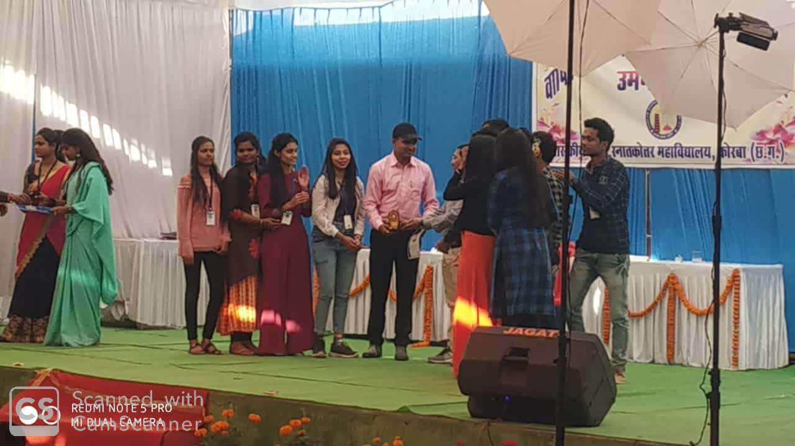
Students of the department received second price for the best paper presentation in district level research seminar.

Slide 11
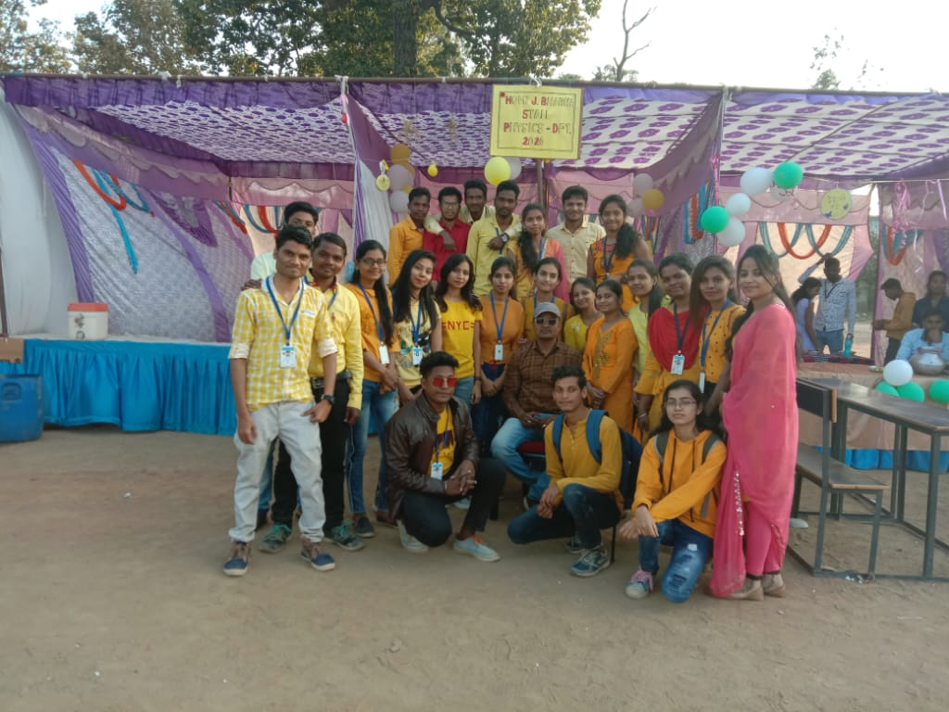
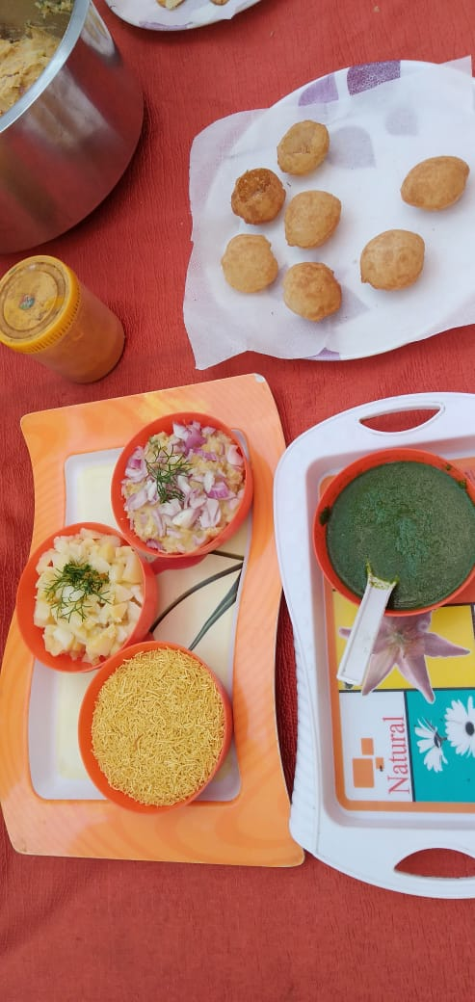
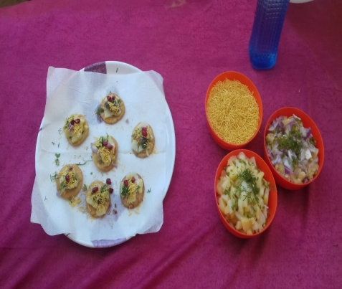
Participation in Cultural Programs

